Slide 1


Turning The Spotlight On Minority-Owned Small Businesses

Slide 2
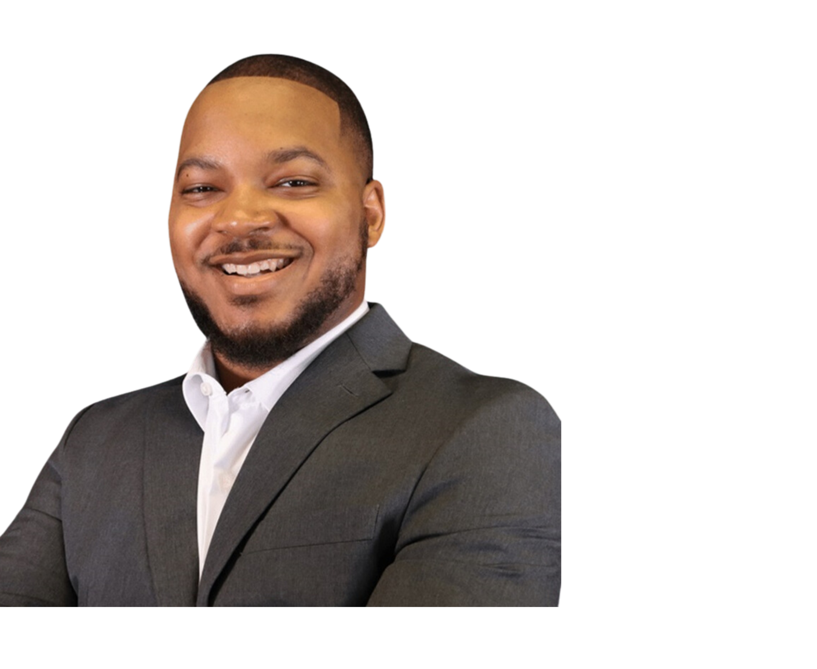
Our Speaker from Financial Plus Credit Union
Who we are
Allen Williams, NDCCDP
DEI Business Partner

Slide 3
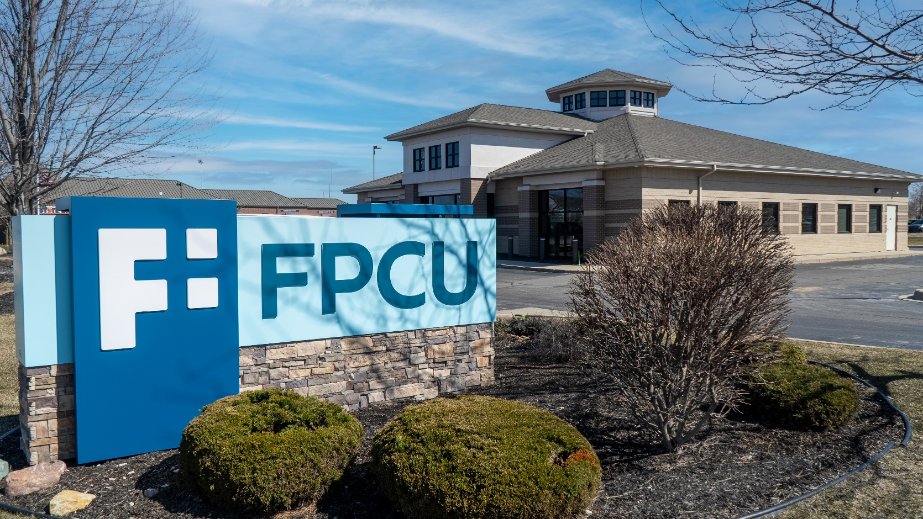
Who we are
About Financial Plus Credit Union
Flint, MI
Approx. $1.3B in assets
Over 82,000 members
276 FTEs
12 branches
Notes:
Madie find Fenton pic

Slide 4
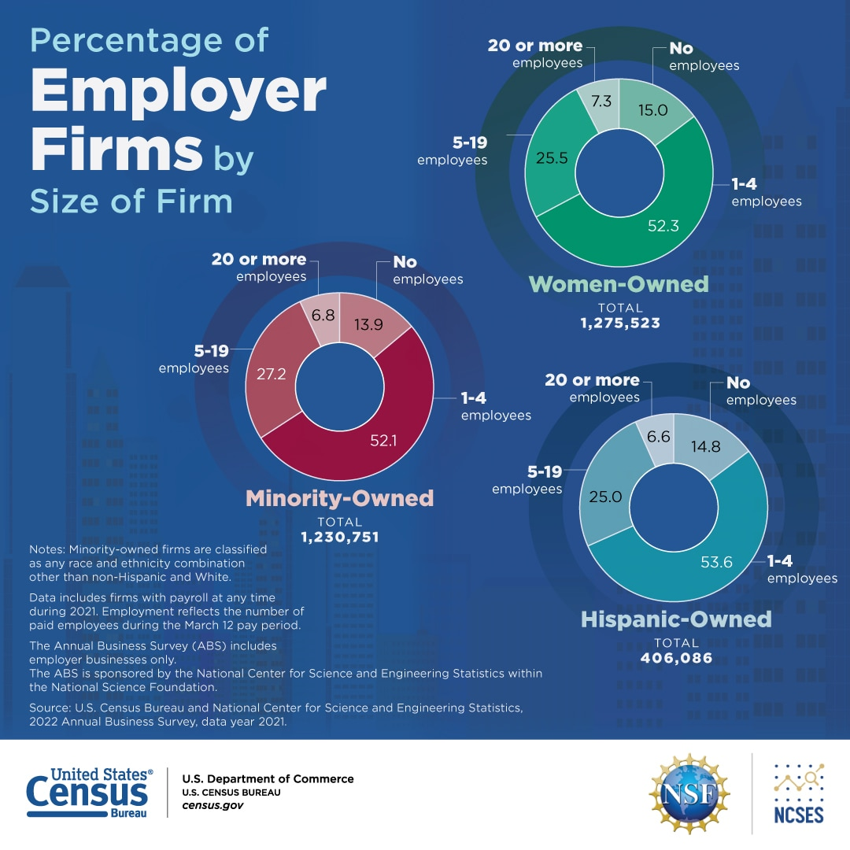
Who we are
The Challenge/Opportunity
Sustaining a small business can be challenging.
Latest U.S. Census Data shows increased growth in minority-owned businesses, but they remain underrepresented.
We recognize the challenges minority-owned business owners face.
Advertising can be the one piece missing for a successful small business.
Data from October 26, 2023

Slide 5

The Billboards of Inclusion Contest
Created “Billboards of Inclusion” in August 2023.
Submissions open to small business owners in MI.
Winners worked with our in-house marketing team to design a billboard that reflects their brand identity and community impact.
Awarded two winners with four weeks of billboard advertising.
Exposure is invaluable for small businesses.
Notes:
**submissions open regardless of CU membership

Slide 6
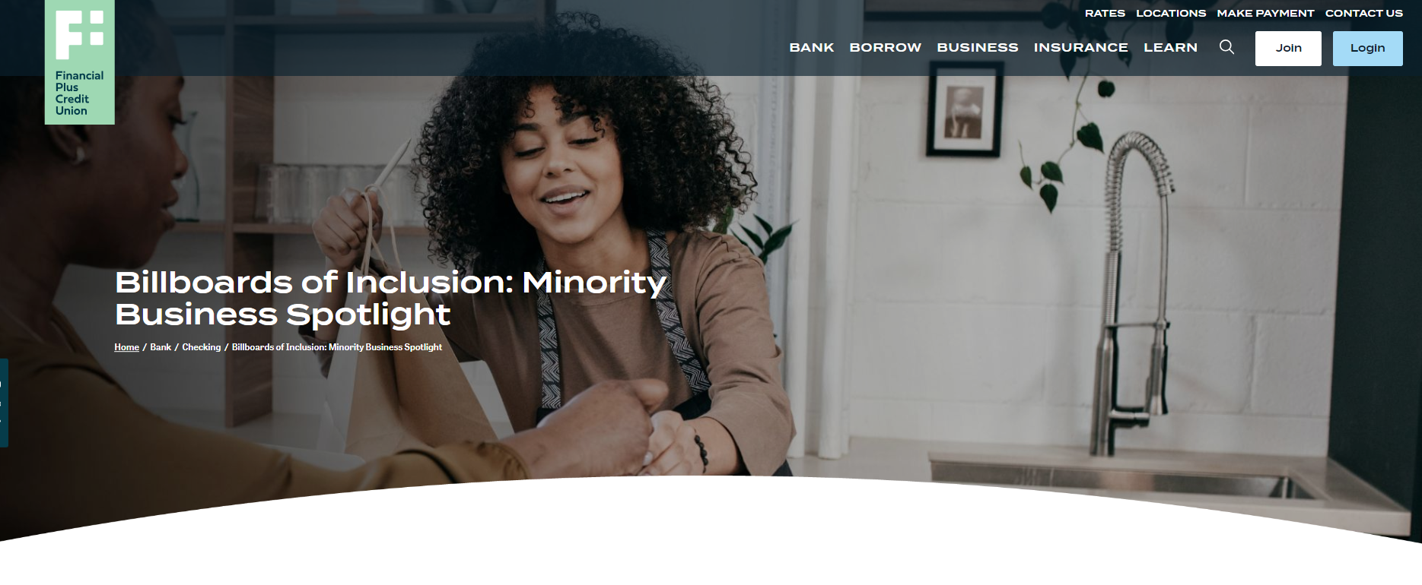
View the application & full contest details for 2024 here.

Slide 7
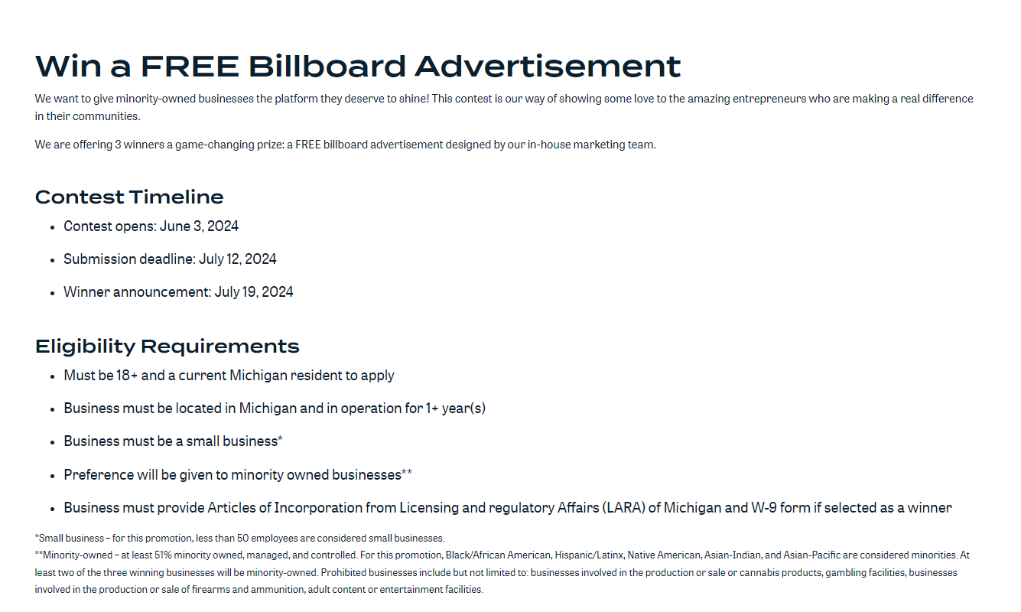

Slide 8
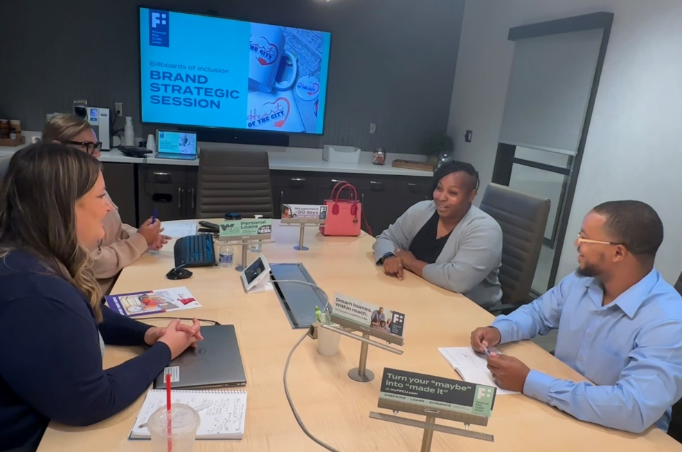
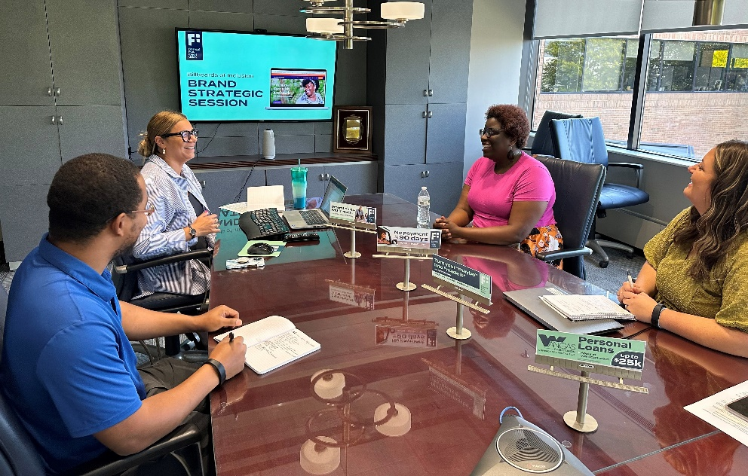
Spreading the Word + Winner Selection
Leaned on community relationships to promote the contest.
FPCU selection committee received over 50 applications.
  Used a scorecard to select winners.
  Individuals recused themselves from scoring entrants they knew.
Winners: Harris Family Health and Heart of the City Development Center.
Notes:
local chambers of commerce, African American advisory committees, minority business directories, and other community networks. I also talked it up on the radio and on-stage at a cultural festival the credit union sponsored.
and taking into consideration whether applicants addressed all contest questions, showed originality and authenticity in their ideas, and provided comprehensive responses.

Slide 9
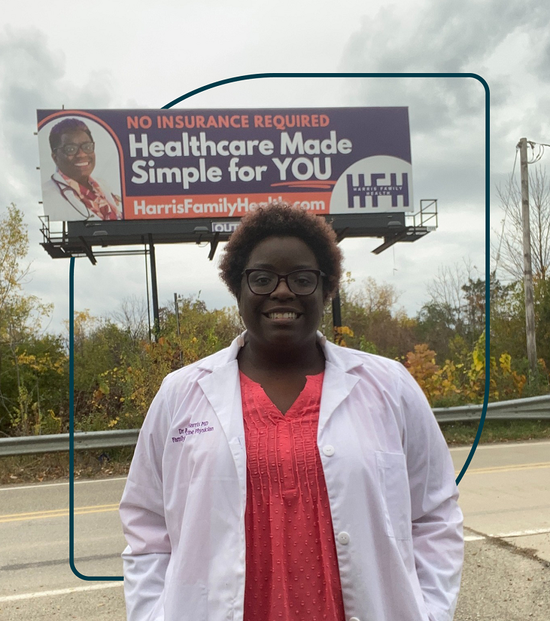
Harris Family Health is Flint’s first direct primary care clinic. The organization serves individuals facing barriers to traditional medical services.

Slide 10
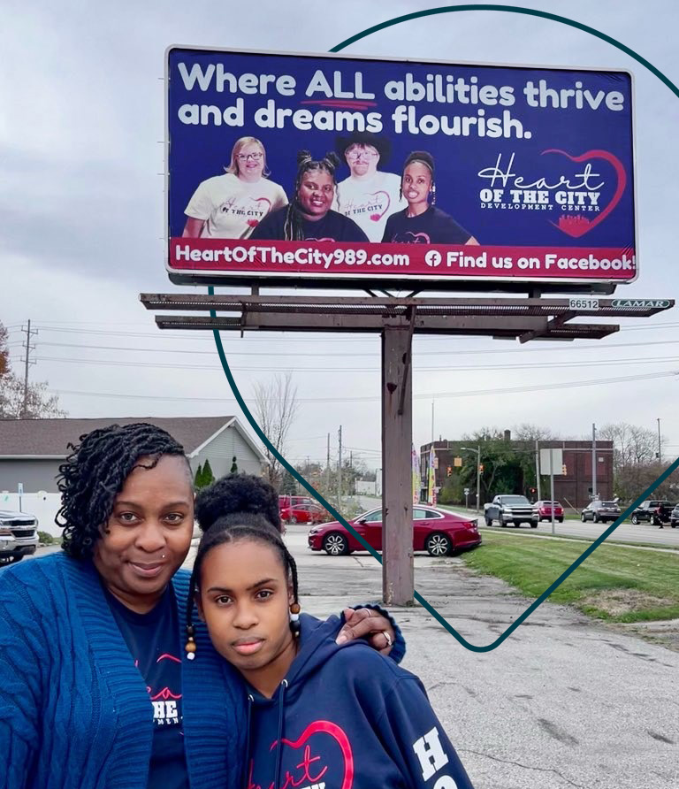
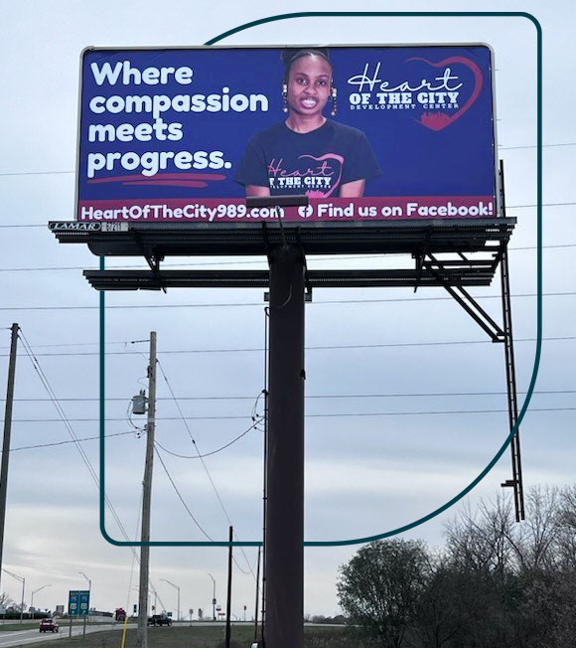
Heart of the City Development Center orchestrates events focused on developing essential skills in a secure environment.
Notes:
After raising a daughter with special needs, Cherie Long identified a disparity in the support and resources accessible to adults with intellectual and developmental disabilities.

Slide 11
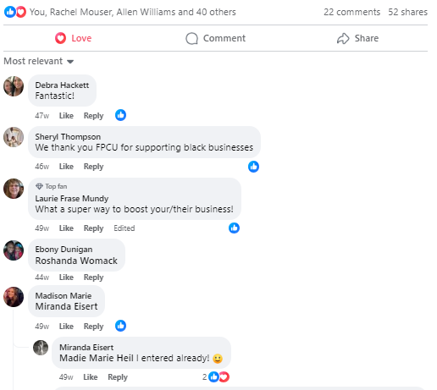
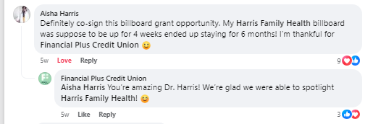
Who we are
Financial Plus is a CDFI committed to serving diverse communities.
Being a good corporate citizen within the communities we serve.
Ensure we have the tools to be a resource for minority-owned businesses.
A Broader Strategy
Notes:
Billboards of Inclusion dovetails with our broader strategy to achieve financial inclusion. Supporting businesses and promoting homeownership to minimize racial gaps.
encapsulates our DEI strategy.
— whether that means opening accounts, promoting local businesses during Black History Month and Hispanic Heritage Month, or showcasing exceptional minority-owned businesses through a contest like this one.

Slide 12
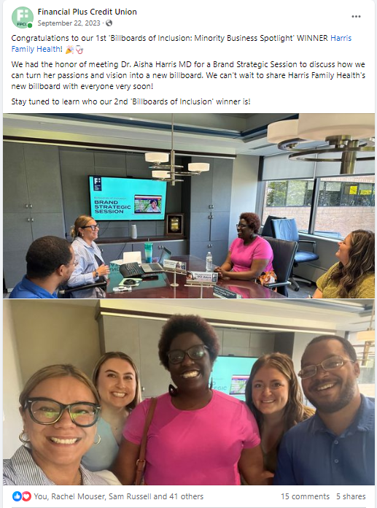
Tracking Impact
Received figures from our agency partner detailing billboard impressions.
Harris Family Health board up for six months.
Billboards lack mention of Financial Plus.
Shared photos of the billboards on socials.
Contest influenced consumers to bank with a local credit union.
Notes:
That can happen when advertisers have not purchased follow-on placements.
rather than a large bank focused on national promotions
because the goal of the contest was to showcase the winners.

Slide 13


Who we are
Lessons Learned + Future Plans
Do your research before creating a new initiative.
Involve your Compliance Department when sponsoring a contest.
We hosted the contest in 2024 with three winners.
Allow more time for all phases and get billboards up in Q3.
Notes:
In our community, billboards work well, but in your community, it might be a website or a commercial or something entirely different.
when it’s warmer and traffic tends to be higher

Slide 14
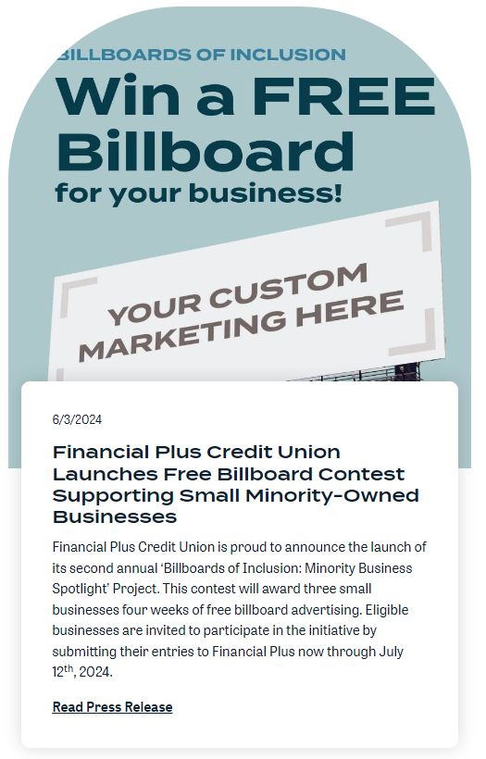
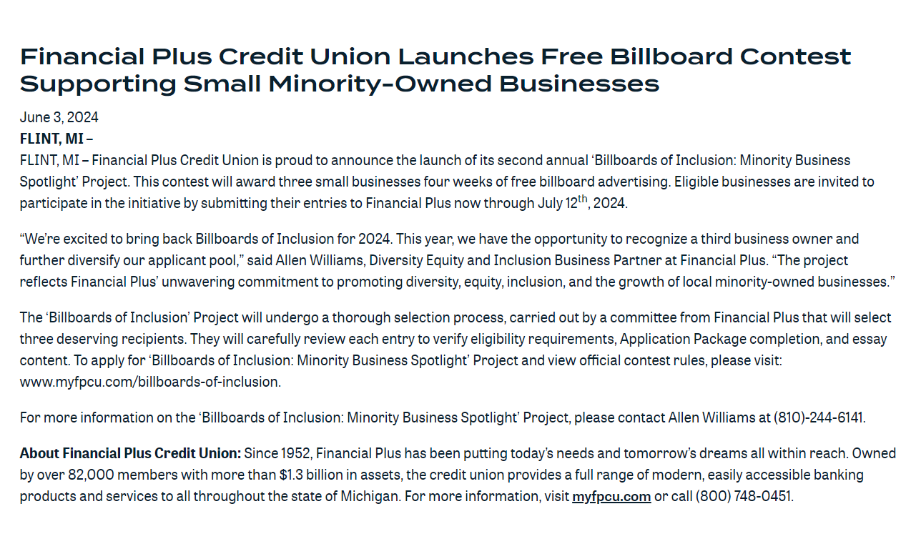
2024 Campaign

Slide 15

Q&A Discussion Period

Slide 16
  THANK YOU FOR WATCHING
1001 Connecticut Ave NW
Ste. 1001
Washington, DC 20036
callahan@callahan.com
www.callahan.com
800-446-7453

